Slide 1























¿Cuál lenguaje de programación debo escoger?

Slide 2
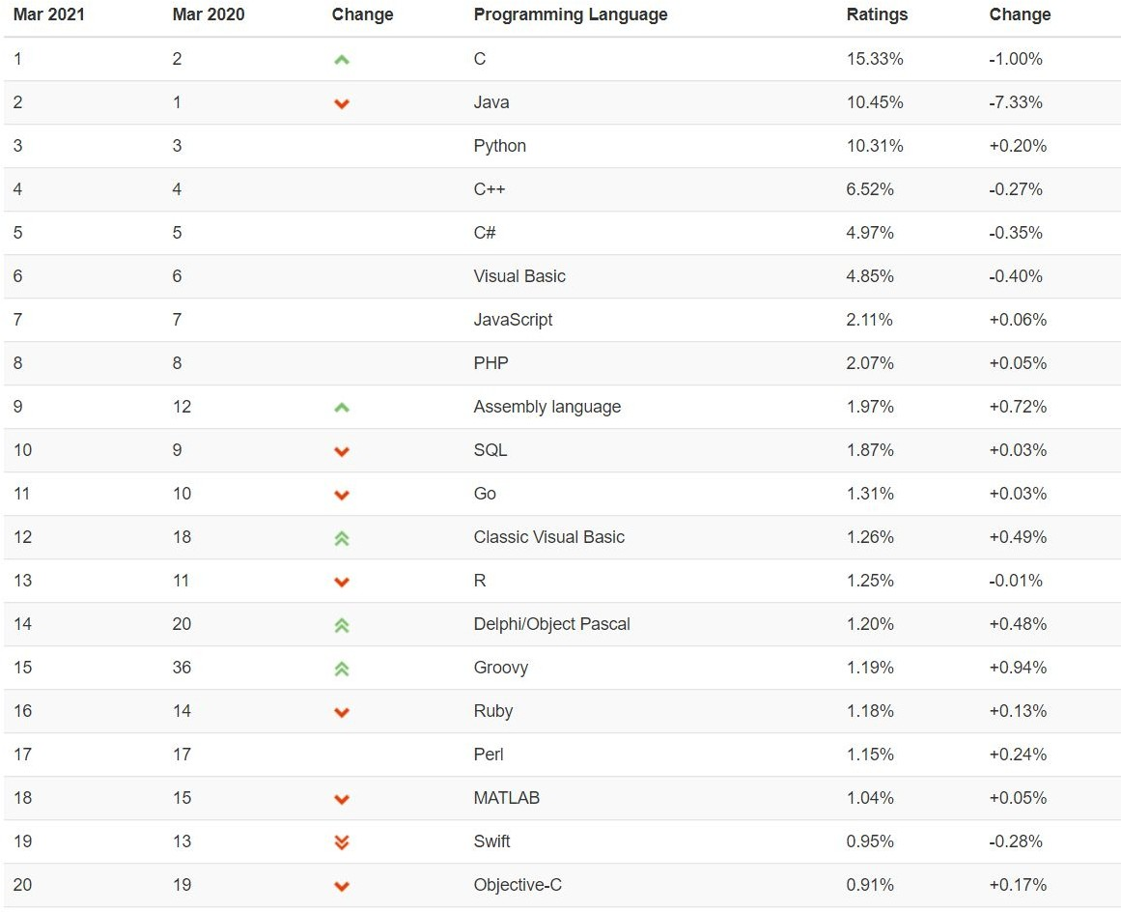

TIOBE Marzo 2021
Fuente: https://www.tiobe.com/tiobe-index/

Slide 3
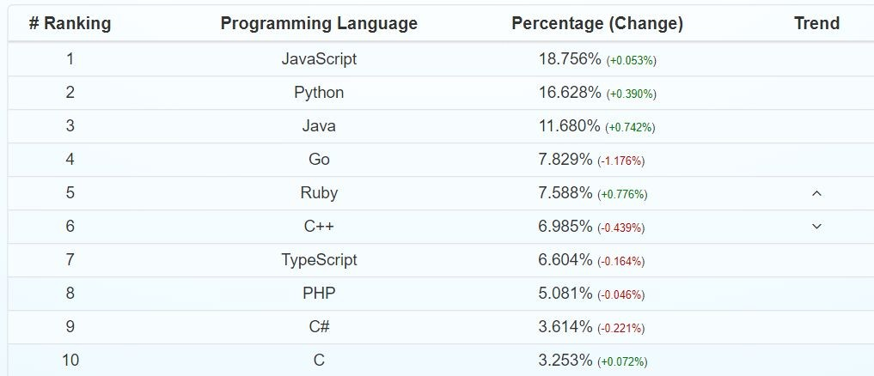
Github 2021 Q1
Fuente: https://madnight.github.io/githut/#/pull_requests/2021/1

Slide 4
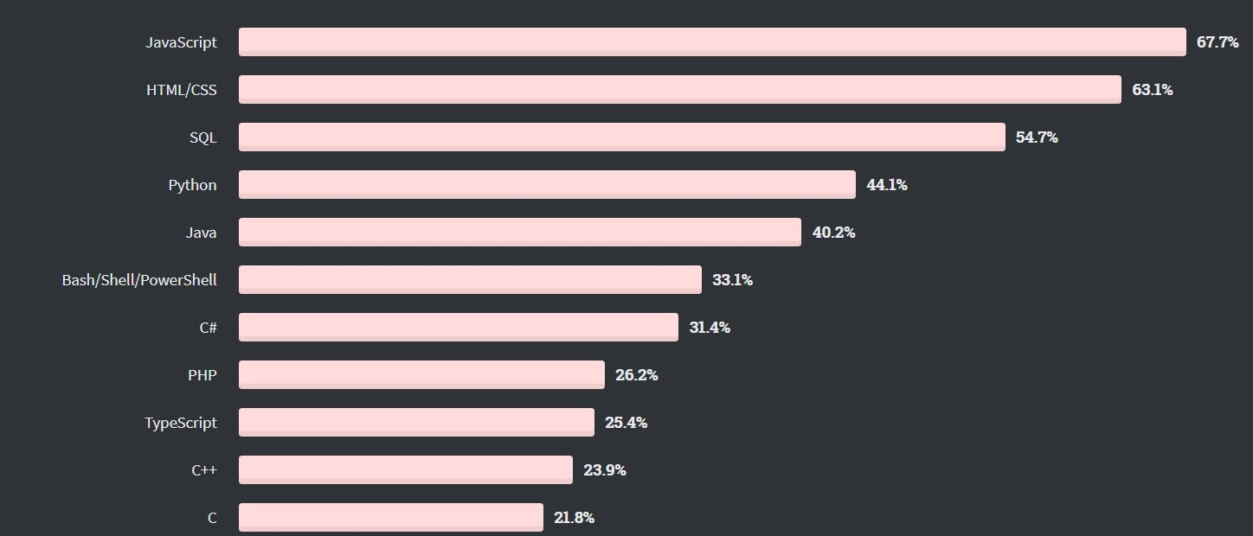
Stackoverflow 2020
Fuente:
https://insights.stackoverflow.com/survey/2020#technology-programming-scripting-and-markup-languages-all-respondents

Slide 5
Desarrollo Desktop
AWT | Windows Forms | GTK | QT
Swing | Windows Presentation Foundation (WPF) |  | SDL
JavaFX | Universal Windows Platform (UWP) |  | DirectX
 |  |  | OpenGL
PyQT | Electron | GTK | Go-gtk
Tkinter | NW.js | Glimmer | gotk3
Kivy | AppJS |  | qt
WxPython | Meteor |  | walk
PyGUI | Proton Native
 | React Native
 | NodeGUI
kdabir/awesome-groovy

Slide 6

Desarrollo Desktop
AWT | Windows Forms | GTK | QT
Swing | Windows Presentation Foundation (WPF) |  | SDL
JavaFX | Universal Windows Platform (UWP) |  | DirectX
 |  |  | OpenGL
PyQT
Tkinter
Kivy
WxPython
PyGUI
Electron
GTK
Glimmer
Go-gtk
gotk3
qt
walk
NW.js
kdabir/awesome-groovy
AppJS
Meteor
Proton Native
React Native
NodeGUI

Slide 7

Desarrollo Web
Angular
React.js
Vue.js
JQuery
Svelte
Next.js
NestJS*
Nodejs* (Express)
Servlets
JSP
JSF
Primefaces
Omnifaces
Spring Boot
Spring MVC
Webflux
Thymeleaf
Struts
Play
Vaadin
GWT
ZK
ASP .NET
ASP.NET MVC
Web API
Spring.NET
NET Core
Laravel
Symfony
CodeIgniter
Zend
Yii
Django
CherryPy
Pyramid
Grok
Flask
Gorilla
Martini
Beego
Gin
Buffalo
Ruby on Rails
Sinatra
Spring Boot
Spring MVC (REST)
Grails Spring Boot
kdabir/awesome-groovy
Sactix-web
rocket
tide
warp

Slide 8

Desarrollo Web
Angular
React.js
Vue.js
JQuery
Servlets JSP JSF Primefaces Omnifaces Spring Boot Spring MVC Webflux Thymeleaf Struts | ASP .NET ASP.NET MVC Web API | Laravel Symfony CodeIgniter Zend Yii | Django
 |  |  | CherryPy Pyramid Grok Flask
 | Spring.NET
Svelte
Next.js
NestJS*
Nodejs* (Express)
Play
Vaadin
GWT
ZK
Gorilla Martini Beego
●
●
●
Gin
Buffalo
Ruby on Rails
Spring Boot
Spring MVC (REST)
Sinatra
Grails
Spring Boot
kdabir/awesome-groovy
Sactix-web
rocket
tide
warp

Slide 9

Desarrollo Móvil
Android SDK
iOS SDK
IONIC
ReactNative
NativeScript
JQuery Mobile
PhoneGap*
Flutter
Xamarin

Slide 10


Desarrollo Móvil
Android SDK
iOS SDK
IONIC
ReactNative
NativeScript
JQuery Mobile
PhoneGap*
Flutter
Xamarin

Slide 11


Machine Learning y Análisis de Datos
NumPy
SciPy
Scikit-learn
TensorFlow
Keras
PyTorch
Pandas
DBI
odbc
RMySQL,
Deeplearning4j ●
JavaML
Weka JSAT
MOA
Breeze ● Synaptic
Saddle ● Brain.js
Scalalab ●
Epic ●
Apache ● Spark ●
PL/SQL
T-SQL PL/PgSQL
Flux
Mocha.jl
TensorFlow.jl
ScikitLearn.jl
Merlin
MXNet.jl
RPostgresSQL,●
TensorFlow.js● Mind ConvNetJS Keras.Js
RSQLite
tidyverse
ggplot2
eBay/tsv-utils
Clojure BigData Solutions
tch
rust-bert
linfa

Slide 12
Machine Learning y Análisis de Datos
NumPy
SciPy
Scikit-learn
TensorFlow
Keras
PyTorch
Pandas
DBI
odbc
RMySQL,
Deeplearning4j ●
JavaML
Weka JSAT
MOA
Breeze ● Synaptic
Saddle ● Brain.js
Scalalab ●
Epic ●
Apache ● Spark ●
PL/SQL
T-SQL PL/PgSQL
Flux
Mocha.jl
TensorFlow.jl
ScikitLearn.jl
Merlin
MXNet.jl
RPostgresSQL,●
TensorFlow.js● Mind ConvNetJS Keras.Js
RSQLite
tidyverse
ggplot2
eBay/tsv-utils
Clojure BigData Solutions
tch
rust-bert
linfa

Slide 13
Videojuegos
SFML
GLFW
Unity
Unity
Duality
AGKSharp
MonoGame
Cocos2d-x
Phaser
Banshee 3D
Jumper
Vivid
Busted
Lume
LWJGL
LibGDX
Qt Jambi
Pygame
PyKyra
Pyglet
PyOpenGL
Kivy
Panda3D
Cocos2d
Arcade
VR

Slide 14



Videojuegos
SFML
GLFW
Unity
Unity
Duality
AGKSharp
MonoGame
Cocos2d-x
Phaser
Banshee 3D
Jumper
Vivid
Busted
Lume
LWJGL
LibGDX
Qt Jambi
Pygame
PyKyra
Pyglet
PyOpenGL
Kivy
Panda3D
Cocos2d
Arcade
VR

Slide 15

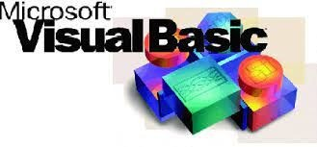


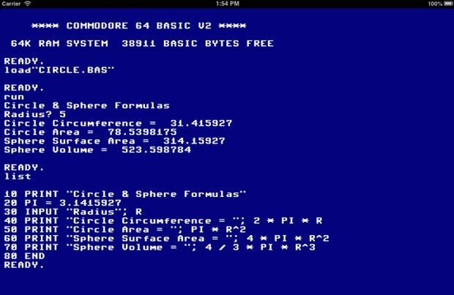

Scripting, Network, Batch, Mainframes, OS, Servers

Slide 16

Scripting, Network, Batch, Mainframes, OS, Servers

Slide 17
¡Gracias

